Slide 1

McGraw-Hill Technology Education
Copyright © 2006 by The McGraw-Hill Companies, Inc. All rights reserved.

Slide 2
Chapter 9A
Network Basics

Slide 3
Network Definition
Set of technologies that connects computers
Allows communication and collaboration between users

Slide 4
The Uses of a Network
Simultaneous access to data
  Data files are shared
    Access can be limited
  Shared files stored on a server
  Software can be shared
    Site licenses
    Network versions
    Application servers
Notes:
Teaching Tip
Figure 9A.2 on page 342 visually describes the sharing process. It can be helpful to have students open a shared file that you control. Make a change then have the students open it again. Alternatively, share a document and allow your students to write in it. Then demonstrate how the shared document changes.
Spend time discussing why application servers need to be so powerful.

Slide 5
The Uses of a Network
Shared peripheral device
  Printers and faxes are common shares
  Reduces the cost per user
  Devices can be connected to the network
  Print servers control network printing
    Manage the print queue
Notes:
Teaching tip
Figure 9A.4 on page 344 shows a print queue. It can be helpful to demonstrate your classroom queue.

Slide 6
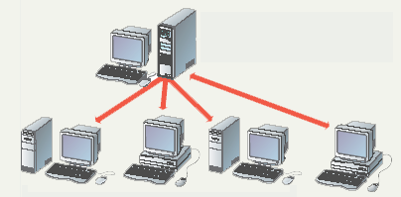
Sharing Data
File server contains documents used by other computers.

Slide 7
The Uses of a Network
Personal communication
  Email
    Instantaneous communication
  Conferencing
    Tele conferencing
    Videoconferencing
    Audio-conferencing
    Data-conferencing
  Voice over IP
    Phone communication over network wires
Notes:
Teaching tip
It is fun if you can setup a teleconference in your classroom. Students get to learn how to join or create the conference. Additionally, they learn how to participate. Finally, students have fun, especially with shared whiteboards.

Slide 8
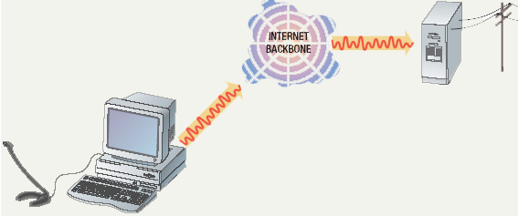
Voice Over IP

Slide 9
The Uses of a Network
Easier data backup
  Backup copies data to removable media
  Server data backed up in one step
Notes:
Insider information
The text describes needing special software to back up data from user drives. However, the backup utility that comes with Windows 2000 and XP is capable of performing this chore.

Slide 10
Common Network Types
Local Area Network (LAN)
  Contains printers, servers and computers
  Systems are close to each other
  Contained in one office or building
  Organizations often have several LANS
Notes:
Teaching tip
Use a real world example to describe an organization with interconnected LANs.

Slide 11
Common Network Types
Wide Area Networks (WAN)
  Two or more LANs connected
  Over a large geographic area
  Typically use public or leased lines
    Phone lines
    Satellite
  The Internet is a WAN
Notes:
Teaching tip
Blockbuster Video uses a WAN to connect it’s stores nationwide. Customers from Pittsburgh may rent videos in Hilton Head. Late fees will even be displayed!

Slide 12
Hybrid Network Types
Campus Area Networks (CAN)
  A LAN in one large geographic area
  Resources related to the same organization
  Each department shares the LAN

Slide 13
Hybrid Network Types
Metropolitan Area Network (MAN)
  Large network that connects different organizations
  Shares regional resources
  A network provider sells time
Notes:
Teaching tip
An example of a regional resource is a supercomputer. For example, Pittsburgh has the Pittsburgh Super Computing center (www.psc.edu). The various colleges in Pittsburgh connect to the center through a MAN in Pittsburgh.

Slide 14
Hybrid Network Types
Home Area Network (HAN)
  Small scale network
  Connects computers and entertainment appliances
  Found mainly in the home

Slide 15
Hybrid Network Types
Personal Area Network (PAN)
  Very small scale network
  Range is less than 2 meters
  Cell phones, PDAs, MP3 players
Notes:
Insider information
PAN is very new. Few devices support PAN. High end cell phones include Bluetooth technology. Once the technology matures, Bluetooth will allow the creation of a PAN.

Slide 16
How Networks Are Structured
Server based network
  Node is any network device
  Servers control what the node accesses
  Users gain access by logging in
  Server is the most important computer
Notes:
Teaching tip
Spend a few minutes here discussing password policies. Describe why it is important not to give out a password. Also describe why longer, more complicated passwords are important.

Slide 17
How Networks Are Structured
Client/Server network
  Nodes and servers share data roles
  Nodes are called clients
  Servers are used to control access
  Database software
    Access to data controlled by server
  Server is the most important computer

Slide 18
How Networks Are Structured
Peer to peer networks (P2PN)
  All nodes are equal
  Nodes access resources on other nodes
  Each node controls its own resources
  Most modern OS allow P2PN
  Distributing computing is a form
  Kazaa
Notes:
Teaching tip
Discuss how users managing their own security settings can be bad.

Slide 19
Network Topologies
Topology
  Logical layout of wires and equipment
  Choice affects
    Network performance
    Network size
    Network collision detection
  Several different types
Notes:
Teaching tip
Discuss how your network topology handles collisions. If your students are technical, contrast this with an inferior topology.

Slide 20
Network Topologies
Packets
  Pieces of data transmitted over a network
    Packets are created by sending node
    Data is reassembled by receiving node
  Packet header
    Sending and receiving address
  Packet payload
    Number and size of data
    Actual data
  Packet error control
Notes:
Teaching tip
For technical students take the time to draw the packet structure on the board. The typical structure is destination address | sending address | packet number | total packets | data size | payload | error control.

Slide 21
Network Topologies
Bus topology
  Also called linear bus
  One wire connects all nodes
  Terminator ends the wires
  Advantages
    Easy to setup
    Small amount of wire
  Disadvantages
    Slow
    Easy to crash
Notes:
Teaching tip
Pages 352 and 353 have diagrams of each network topology

Slide 22
Network Topologies
Star topology
  All nodes connect to a hub
    Packets sent to hub
    Hub sends packet to destination
  Advantages
    Easy to setup
    One cable can not crash network
  Disadvantages
    One hub crashing downs entire network
    Uses lots of cable
  Most common topology

Slide 23
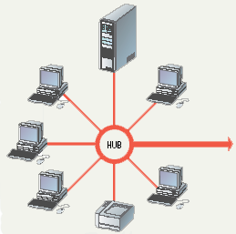
Star Topology

Slide 24
Network Topologies
Ring topology
  Nodes connected in a circle
  Tokens used to transmit data
    Nodes must wait for token to send
  Advantages
    Time to send data is known
    No data collisions
  Disadvantages
    Slow
    Lots of cable

Slide 25
Network Topologies
Mesh topology
  All computers connected together
  Internet is a mesh network
  Advantage
    Data will always be delivered
  Disadvantages
    Lots of cable
    Hard to setup

Slide 26
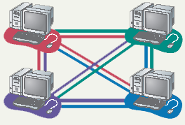
Mesh Topology

Slide 27
Network Media
Links that connect nodes
Choice impacts
  Speed
  Security
  Size

Slide 28
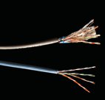
Wire Based Media
Twisted-pair cabling
  Most common LAN cable
  Called Cat5 or 100BaseT
  Four pairs of copper cable twisted
  May be shielded from interference
  Speeds range from
  1 Mbps to 1,000 Mbps
Notes:
Insider information
Interference is usually electrical. Magnets, solar flares or electronic devices generate interference.

Slide 29
Wire Based Media
Coaxial cable
  Similar to cable TV wire
  One wire runs through cable
  Shielded from interference
  Speeds up to 10 Mbps
  Nearly obsolete

Slide 30
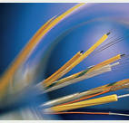
Wire Based Media
Fiber-optic cable
  Data is transmitted with light pulses
  Glass strand instead of cable
  Immune to interference
  Very secure
  Hard to work with
  Speeds up to
  100 Gbps
Notes:
Teaching tip
Remind students that bps is bits per second. Gbps then is billion bits per second.

Slide 31
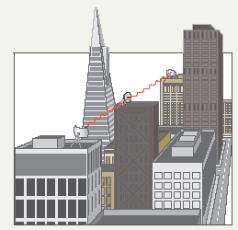
Wireless Media
Data transmitted through the air
LANs use radio waves
WANs use microwave signals
Easy to setup
Difficult to secure
Notes:
Teaching tip
Now is the time to briefly discuss 802.11 standards. A full discussion of 802.11 is covered in the next section.

Slide 32

Network Hardware
Network interface cards
  Network adapter
  Connects node to the media
  Unique Machine Access Code (MAC)
Notes:
Insider Information
The Xerox Corporation controls the assignment of Ethernet addresses to NIC manufacturers.

Slide 33
Network Hardware
Network linking devices
  Connect nodes in the network
  Cable runs from node to device
  Crossover cable connects two computers

Slide 34
Network Hardware
Hubs
  Center of a star network
  All nodes receive transmitted packets
  Slow and insecure

Slide 35
Network Hardware
Switches
  Replacement for hubs
  Only intended node receives transmission
  Fast and secure
Notes:
Insider information
Twisted pair networks cannot achieve higher than 10 Mbps using a hub. Switches are necessary to achieve 100 Mbps or higher.

Slide 36
Network Hardware
Bridge
  Connects two or more LANs together
  Packets sent to remote LAN cross
    Other packets do not cross
  Segments the network on MAC addresses

Slide 37

Network Hardware
Router
  Connects two or more LANs together
  Packets sent to remote LAN cross
  Network is segmented by IP address
  Connect internal networks to the Internet
  Need configured before installation
Notes:
Discussion point
Ask who in the class has high speed Internet. Then determine if anyone is sharing this to the rest of the house or dorm. If they are, see if they can describe the setup. Most likely, the sharing is done with a router.

Slide 38
Network Hardware
Gateway
  Connects two dissimilar networks
  Connects coax to twisted pair
  Most gateways contained in other devices

Slide 39
Network Cabling
Cabling specifications
  Bandwidth measures cable speed
    Typically measured in Mbps
  Maximum cable length
  Connector describes the type of plug

Slide 40

Network Cabling
Ethernet
  Very popular cabling technology
  10 Base T, 10Base2, 10Base5
  Maximum bandwidth 10 Mbps
  Maximum distances100 to 500 meters

Slide 41
Network Cabling
Fast Ethernet
  Newer version of Ethernet
  Bandwidth is 100 Mbps
  Uses Cat5 or greater cable
    Sometimes called 100Base T
  Requires a switch
Notes:
Teaching tip
Point out that the speed of the cable is the number before the word Base.

Slide 42
Network Cabling
Gigabit Ethernet
  High bandwidth version of Ethernet
  1 to 10 Gbps
  Cat 5 or fiber optic cable
  Video applications

Slide 43
Network Cabling
Token ring
  Uses shielded twisted pair cabling
  Bandwidth between 10 and 25 Mbps
  Uses a multiple access unit (MAU)
  Popular in manufacturing and finance

Slide 44
Network Protocols
Language of the network
  Rules of communication
  Error resolution
  Defines collision and collision recovery
  Size of packet
  Naming rules for computers

Slide 45
Network Protocols
TCP/IP
  Transmission Control Protocol/Internet Protocol
  Most popular protocol
  Machines assigned a name of 4 numbers
    IP address
    209.8.166.179 is the White House’s web site
  Dynamic Host Configuration Protocol
    Simplifies assignment of IP addresses
  Required for Internet access
Notes:
Teaching tip
Have students determine IP addresses for the computer. On 2000/XP enter ipconfig /all. Windows 98 and back enter winipcfg.

Slide 46
Network Protocols
IPX/SPX
  Internet Packet Exchange/Sequenced Packet Exchange
  Older protocol
  Associated with Novell Netware
  Replaced by TCP/IP

Slide 47
Network Protocols
NetBEUI
  Network BIOS Extended User Interface
  Used by Windows to name computers
  Transmission details handled by TCP/IP
Notes:
Discussion Point
Have students tell you what BIOS stands for.

Slide 48
Network Protocols
Token ring
  Popular in manufacturing and finance
  Nodes communicate when they have the token

Slide 49
Chapter 9A
End of Chapter

